Slide 1
Sapne Aapke Bharosa Apno Ka

Slide 2
Vision
“To be the most Preferred Financial Service provider to every Indian Entrepreneur”
Mission
“To provide Simple and Fast Asset Acquisition Solutions
for Machines & Equipment to Small & Medium Enterprises by proactive collaboration with manufacturers ”

Slide 3

Milestones
2014
47 Operational Branches & growing
Recognized as Best NBFC by India SME Forum
AUM crossed Rs. 1000 Cr
Introduction of PE & 18 branches
2013
2012
Honored as the Leading NBFC in SME Finance
by SME Chamber of India
First off- Balance Sheet funding / Recognized as NBFC ND-SI
2011
2009
Cumulative Disbursement of Rs.
500 Cores / Decentralization of Operations
Reincarnation of the company /
Blueprint to grow
2008
2005
Machinery Manufacturer oriented
business strategy / Tie-up with Machine Manufacturers
2003
Dominant market player in funding DG sets
2000
Focus on SME Asset funding
Broadening the ownership
structure through IPO
1995
1994
Incorporation of the Company

Slide 4
About Us
Established in 1994
Listed at BSE & DSE
Disbursements till date: Rs 5000 Cr
Motilal invested in Intec as the first PE fund
Leading Indian SME Asset Financial Institution

Slide 5
Target market
Small and Medium Enterprises (SME) sector has emerged as a highly vibrant and dynamic sector of the Indian economy over the last five decades. The Micro- Small and Medium Enterprises (MSMEs) are small sized entities, defined in terms of their size of investment. They are contributing significantly to output, employment export etc. in the economy. They perform a critical role in the economy by providing employment to a large number of unskilled and semi-skilled people, contributing to exports, raising manufacturing sector production and extending support to bigger industries by supplying raw material, basic goods, finished parts and components, etc. Small and medium enterprises (SMEs) are the major contributor to Indian Economy. They provide employment to over 40% of workforce in India and contribute around 45% of manufacturing output (as of Dec 2014).

Slide 6
Definition of MSMEs in India (As Per Micro, Small & Medium Enterprises Development (MSMED) Act, 2006)
HOW MSME’S ARE CLASSIFIED?
Manufacturing Enterprises - Investment in Plant & Machinery
Description | INR | USD($)
Micro Enterprises | upto Rs. 25 Lakh | upto $ 62,500
Small Enterprises | above Rs. 25 Lakh & upto Rs. 5 Crore | above $ 62,500 & upto $ 1.25 million
Medium Enterprises | above Rs. 5 Crore & upto Rs. 10 Crore | above $ 1.25 million & upto $ 2.5 million
Service Enterprises – Investment in Equipment's
Description | INR | USD($)
Micro Enterprises | upto Rs. 10 Lakh | upto $ 25,000
Small Enterprises | above Rs. 10 Lakh & upto Rs. 2 Crore | above $ 25,000 & upto $ 0.5 million
Medium Enterprises | above Rs. 2 Crore & upto Rs. 5 Crore | above $ 0.5 million & upto $ 1.5 million

Slide 7
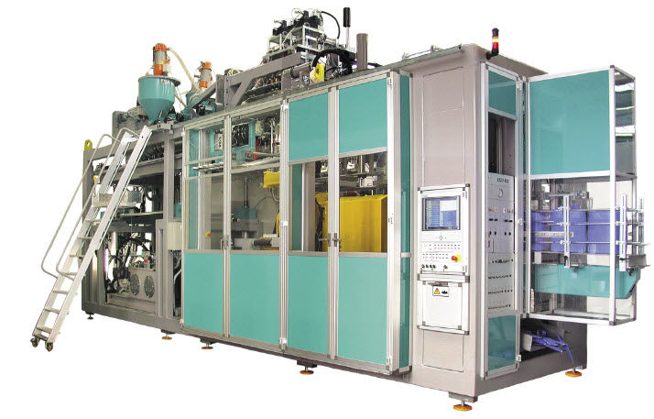


Products
Machine Loan
Business Loan
Collateral Backed Loan- LAP

Slide 8
Products
Un-Secured
Secured
Business Loan
Machine Loan
Loan Against Property
Loan amount- 10 lacs to 50 lacs
Tenure- 20- 28 months
End Use- Working capital for business
Security- Unsecured
Loan amount- 10 lacs to 50 lacs
Tenure- 24- 36 months
End Use- Purchase of new machinery
Security- Hypothecation of machinery
Loan amount- 10 lacs to 2 cr
Tenure- 36- 72 months
End Use- Working capital for business
Security- Registered mortgage of the property

Slide 9
Lending Product
Asset
Credit Norm
TAT
Standard Assets
Viability based analysis.
End to End TAT of 5-7 days
Easy Documentation
Cash flow based credit appraisal.
Revenue Generating Assets

Slide 10
Focus Industries
Auto & Engineering
Printing and Packaging
Plastic and Injection Molding
Pharma, Medical and Healthcare
Food Processing
Retailers
Professional Services
Education
Infrastructure
Construction
Leather
Textiles
Metals
Rubber
Capital Goods & Industrial Equipment

Slide 11
Product Features
No additional Collaterals required
Longer Tenure
Attractive rate of Interest
All Domestic assets
Low documentations
Faster TAT’s
Customized EMI
Credit at sole discretion of Intec

Slide 12
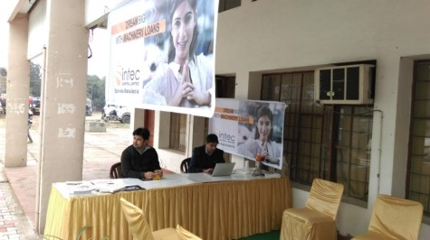
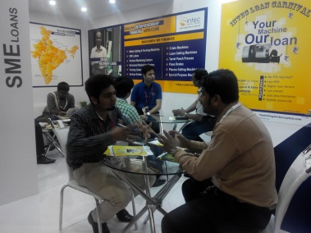
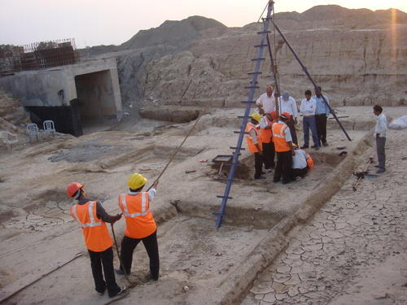
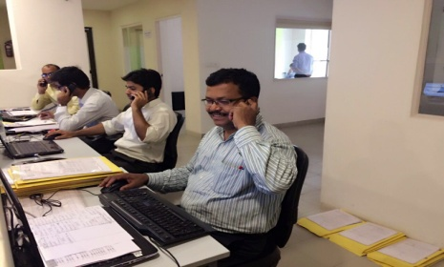
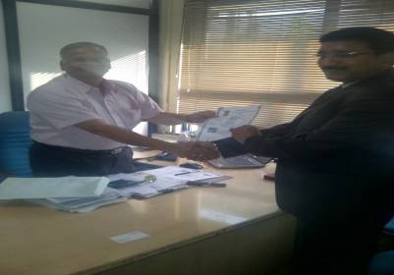
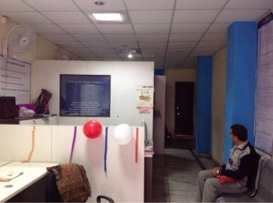
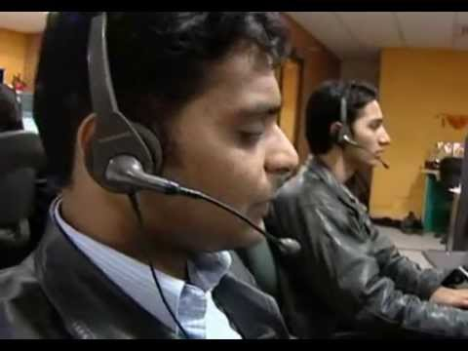
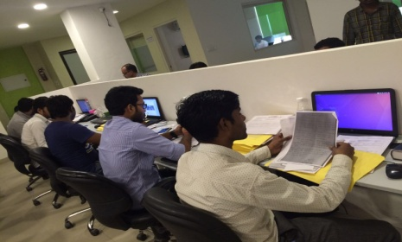

Intec Approach
FO Sourcing
Document Collection
CVO Field Investigation
Case Login
Case Approval
PD Office visit
Telephonic Verification
Credit Appraisal
RTGS/Cheque

Slide 13
Why Intec
Simple & Fast Processes
Innovative
Products
Manufacturer Collaboration
Best in Class Customer Service
Industry Experience
of 23 years

Slide 14
The Intec Proposition
Customised Products
Special Products/ Schemes for Customers
Customised/ Targeted as per customer profile
Dedicated Service Channel
Joint Marketing
Joint Marketing/ Roadshows/ Customer Events
Joint Prospecting
Intec Green Channel – Priority Processing of Cases
Regular Sales Teams meetings
Teamwork
Monthly Review
Product Trainings
Speedy Disbursals
Less Documentation

Slide 15
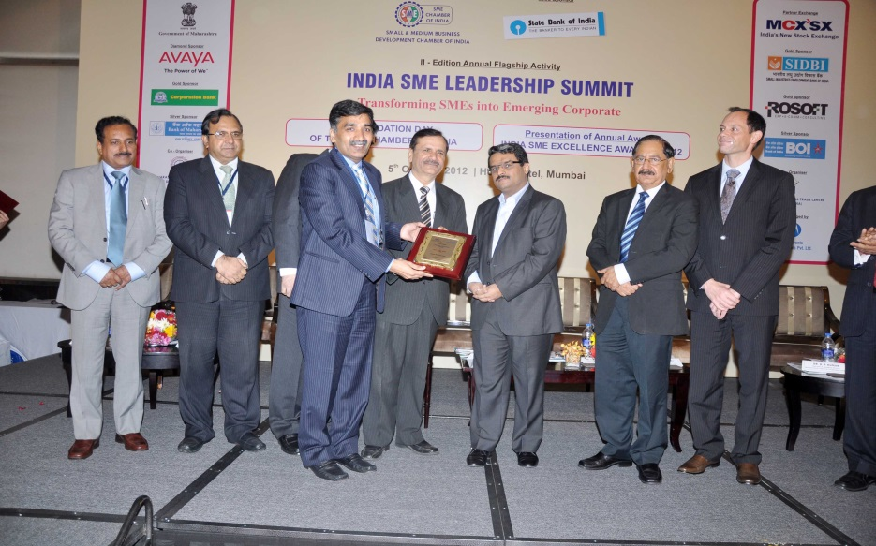
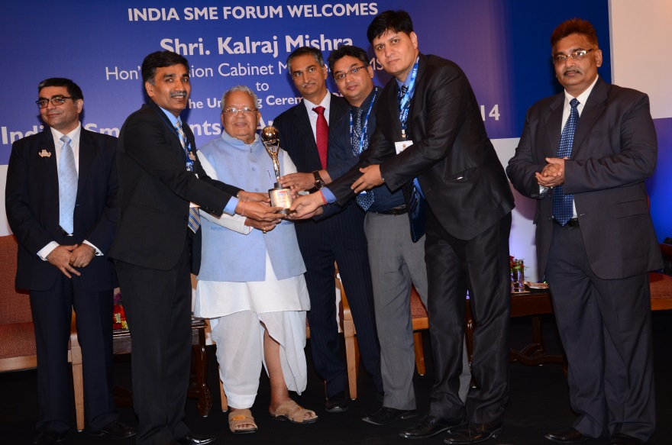
Awards and Accolades
FY 2012-2013
FY 2014-2015
Intec Capital Limited honored as the “Leading NBFC in SME Finance” by SME Chamber of India
Intec Capital Limited being honored as the “Best NBFC” by India SME Forum

Slide 16
Let us join hands to build a Stronger Relationship

